Slide 1


Noise dalam Sistem Komunikasi
DTG2F3
Sistem
Komunikasi
By : Dwi Andi Nurmantris

Slide 2
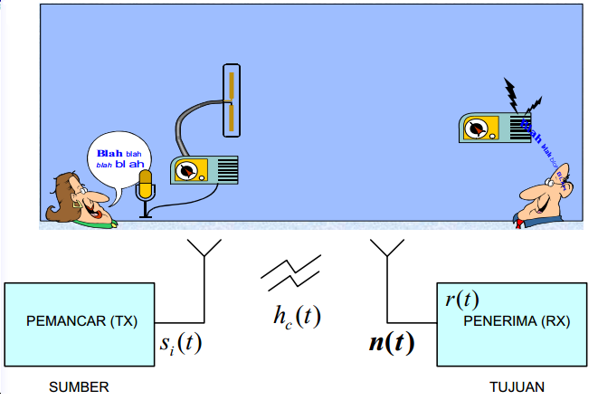
NOISE DALAM SISTEM KOMUNIKASI
Model Komunikasi Radio

Slide 3
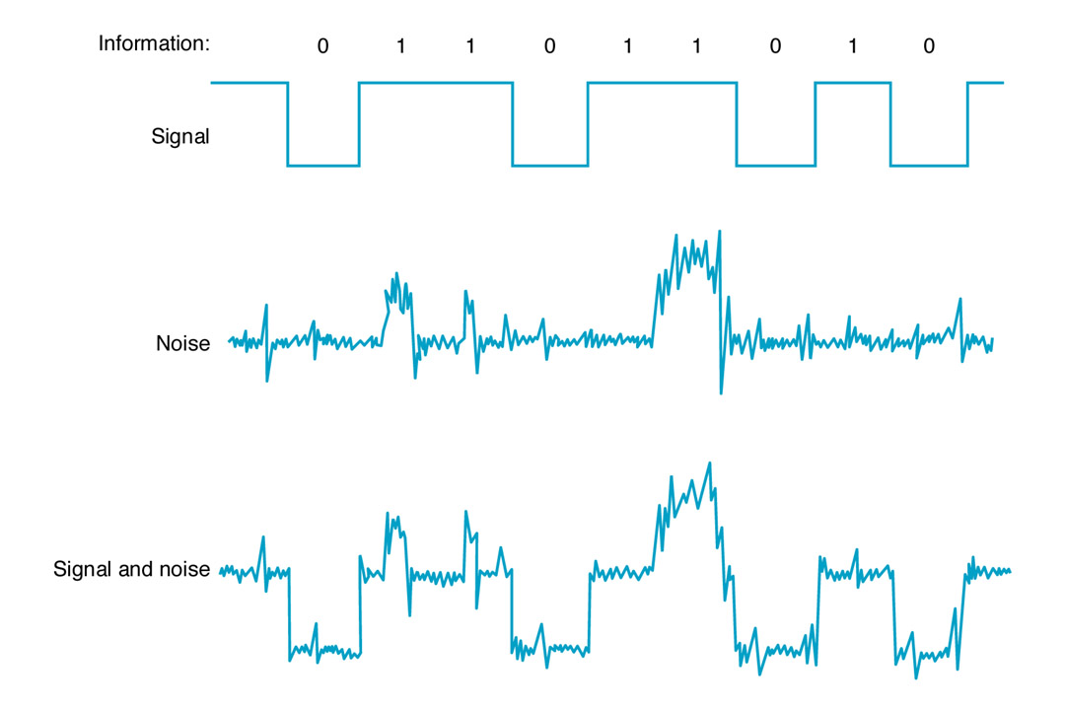
NOISE DALAM SISTEM KOMUNIKASI
What is Noise ?
Undesired random variations that interface with the desired signal and inhibit communication.
Refers to random and unpredictable electrical signals produced by natural process.
Superimposed on information bearing signal, the message partially corrupted or totally erased.
Can be reduced by filtering but can’t totally eliminated.

Slide 4

NOISE DALAM SISTEM KOMUNIKASI
Noise Source

Slide 5
NOISE DALAM SISTEM KOMUNIKASI
Type of Noise
External
1- Manmade (artificial): These could be eliminated via better design
- Machinery
- Switches
- Certain types of lamps
2- Natural
- Atmospheric noise: causing crackles on our radios
- Cosmic noise (space noise):
Internal
Noise in Electrical Components
Thermal noise: Random free electron movement in a conductor (resistor) due to
thermal agitation
Shot noise: Due to random variation in current superimposed upon the DC value.
It is due to variation in arrival time of charge carriers in active devices.
Flicker noise: Observed at very low frequencies, and is thought to be due to
fluctuation in the conductivity of semiconductor devices.

Slide 6
NOISE DALAM SISTEM KOMUNIKASI
External Noise
Human-Made Noise: Noise produced by spark-producing system such as engine ignition systems, fluorescent lights, commutators in electric motors, and power lines.
Atmospheric Noise: Noise caused by naturally occurring disturbances in the earth’s atmosphere.
Space Noise: Noise produced outside the earth’s atmosphere.

Slide 7
NOISE DALAM SISTEM KOMUNIKASI
Internal Noise
Thermal Noise: Noise caused by thermal interaction between free electrons and vibrating ions in a conductor.
Shot Noise: Noise introduced by carriers in the pn junctions of semiconductors
Excess Noise: Noise occurring at frequencies below 1khz, varying in amplitude inversely proportional to the frequence
Transit-Time Noise: Noise produced in semiconductors when the transit time of the carriers crossing a junction is close to the signal’s period.

Slide 8
NOISE DALAM SISTEM KOMUNIKASI
Thermal Noise
Thermal Noise: Noise caused by thermal interaction between free electrons and vibrating ions in a conductor.
Johnson Noise: Another name for thermal noise, first studied by J. B. Johnson in 1928.
White Noise: Another name for thermal noise because its frequency content is uniform across the spectrum.

Slide 9
NOISE DALAM SISTEM KOMUNIKASI
Thermal Noise
P_{n} = kTΔf
k = Boltzmann’s constant (1.38×10⁻²³ J/K)
T = Resistor temperature in kelvin (K)
Δf = Frequency bandwidth of the system
The rms noise voltage en has a maximum at

Slide 10
NOISE DALAM SISTEM KOMUNIKASI
Effect of Noise
One of the main limiting factor in obtaining high performance of a communication system.
Decrease the quality of the receiving signal.
It sets the lower limit for the detectable signals.
It sets the upper limit for system gains.
For Digital systems (it limits the receiver’s ability to make correct symbol decision and thereby limit the rate of information transmission)

Slide 11
NOISE DALAM SISTEM KOMUNIKASI
Noise Effect on Analog and Digital Systems
Analog system
Any amount of noise will create distortion at the output
Digital system
A relatively small amount of noise will cause no harm at all
Too much noise will make decoding of received signal impossible
Both - Goal is to limit effects of noise to a manageable/satisfactory amount

Slide 12
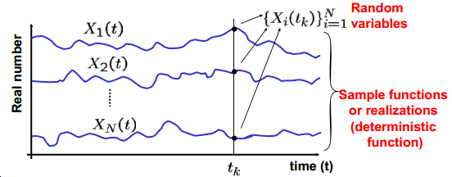
NOISE DALAM SISTEM KOMUNIKASI
Random Process
A random process is a collection of time functions, or signals, corresponding to various outcomes of a random experiment. For each outcome there exists a deterministic function, which is called a sample function or a realization.

Slide 13
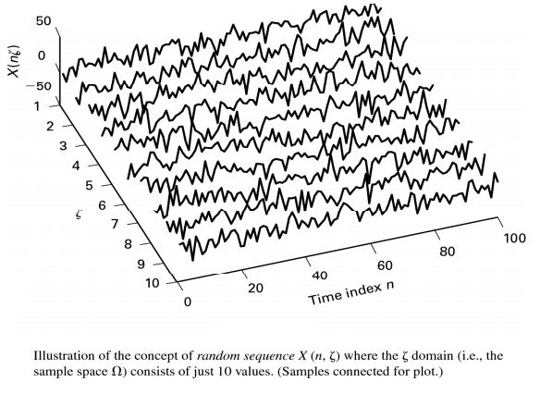
NOISE DALAM SISTEM KOMUNIKASI
Random Sequences or Random Processes

Slide 14
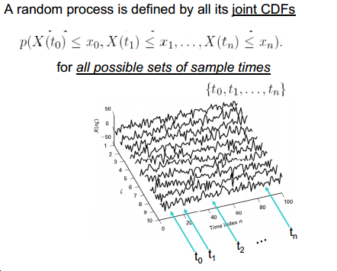
NOISE DALAM SISTEM KOMUNIKASI
Specifying a Random Process

Slide 15
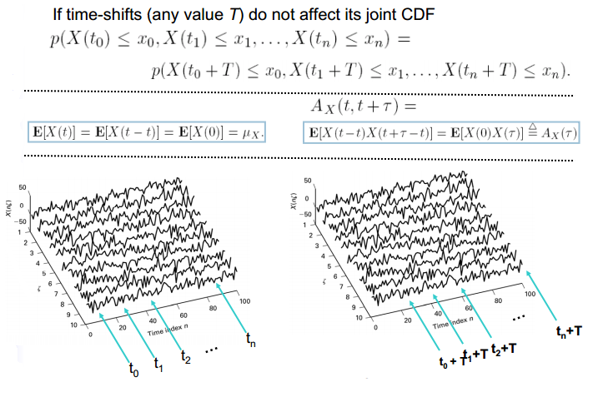
NOISE DALAM SISTEM KOMUNIKASI
Stationarity

Slide 16
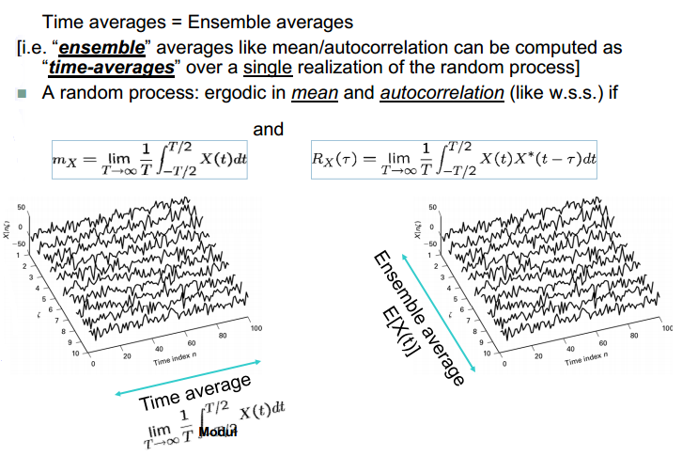
NOISE DALAM SISTEM KOMUNIKASI
Ergodicity

Slide 17
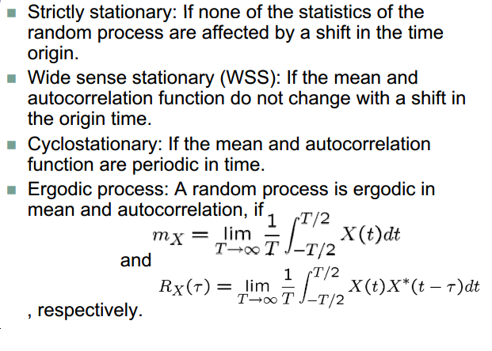
NOISE DALAM SISTEM KOMUNIKASI
Random Process….

Slide 18
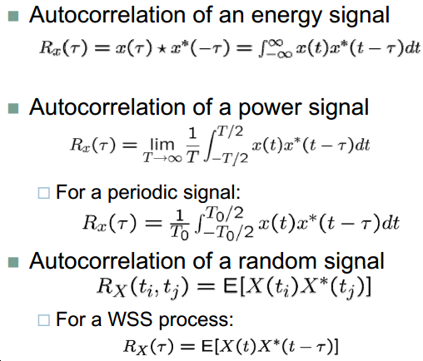
NOISE DALAM SISTEM KOMUNIKASI
Autocorrelation

Slide 19
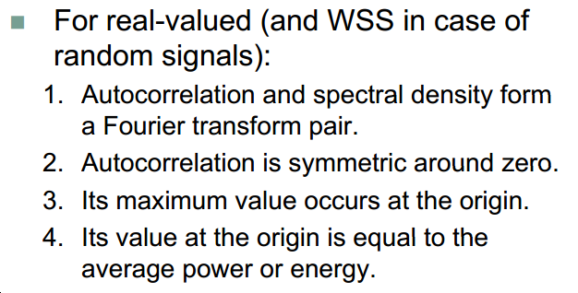
NOISE DALAM SISTEM KOMUNIKASI
Properties of an Autocorrelation Function

Slide 20
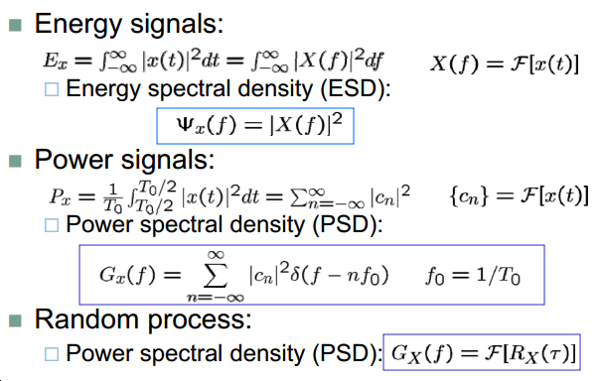
NOISE DALAM SISTEM KOMUNIKASI
Power Spectral Density

Slide 21
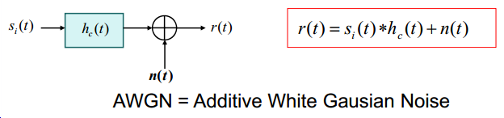
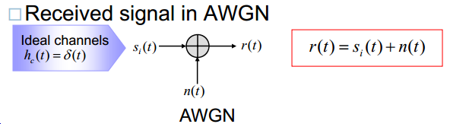
NOISE DALAM SISTEM KOMUNIKASI
Model Sinyal Terima
Model the received signal
Simplify the Model

Slide 22
NOISE DALAM SISTEM KOMUNIKASI
Model Sinyal Terima
Noise / Derau sebagai unsur pengganggu yang hampir selalu terlibat dalam Siskom memerlukan pemodelan yang representative untuk memudahkan keperluan analisis bagi penentuan kualitas ataupun kinerja Siskom.
Klasifikasi noise berdasarkan sumbernya :
Dari luar system
Dari dalam system (umumnya paling dominan)
Klasifikasi noise berdasarkan “equivalensi” dengan suhu:
Thermal-Noise
Non Thermal-Noise
Klasifikasi noise berdasarkan model matematis/statistic :
Gaussian Noise
White noise
White Gaussian Noise

Slide 23
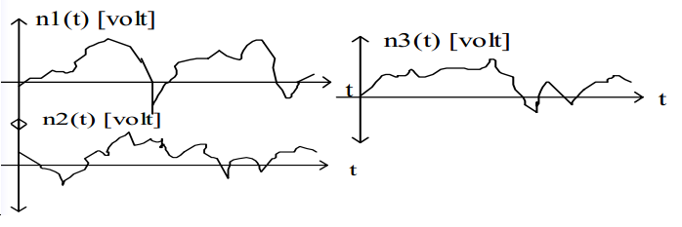
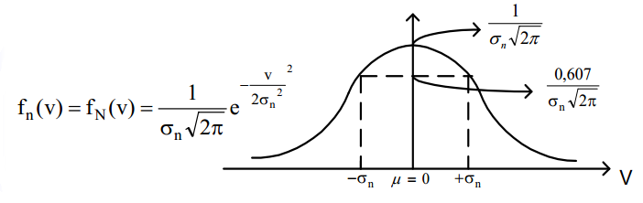
NOISE DALAM SISTEM KOMUNIKASI
Gaussian Noise
Fungsi Distribusi Gauss

Slide 24
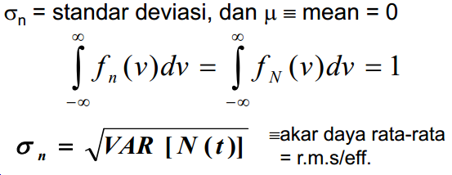
NOISE DALAM SISTEM KOMUNIKASI
Gaussian Noise
Dimana :
Tegangan r.m.s/eff. dapat diukur dengan “ TRUE-RMS VOLT-METER”, yang dapat berupa sinyal apa saja, termasuk NOISE.
Tapi Voltmeter biasa hanya mengukur tegangan rata-rata sin/cos.

Slide 25
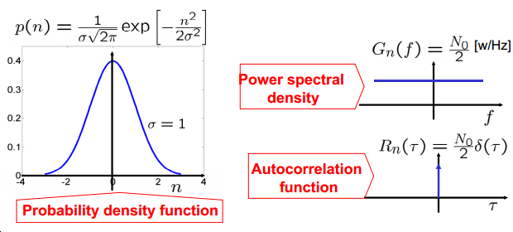
NOISE DALAM SISTEM KOMUNIKASI
White Noise
Its PSD is flat, hence, it is called white noise.

Slide 26
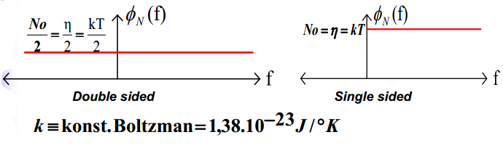
NOISE DALAM SISTEM KOMUNIKASI
AWGN : Additive White Gaussian Noise
Memiliki sifat gabungan antara Gaussian-noise dan white noise
Berupa noise dalam/thermal noise :
Rapat daya noise mempunyai ekuivalensi dengan thermal. Sehingga secara praktis dapat juga noise dinyatakan dalam thermal (ekivalensinya).

Slide 27
NOISE DALAM SISTEM KOMUNIKASI
Performance of Communication Systems
Performance of Communications Systems Corrupted by Noise
Digital
Bit Error Rate (BER)
Analog
Output SNR

Slide 28
NOISE DALAM SISTEM KOMUNIKASI
Noise Remedies
REDUCE BANDWIDTH
INCREASE TRANSMITTER’S
POWER
LOW NOISE AMPLIFIERS

Slide 29


